Slide 1


Slide 2
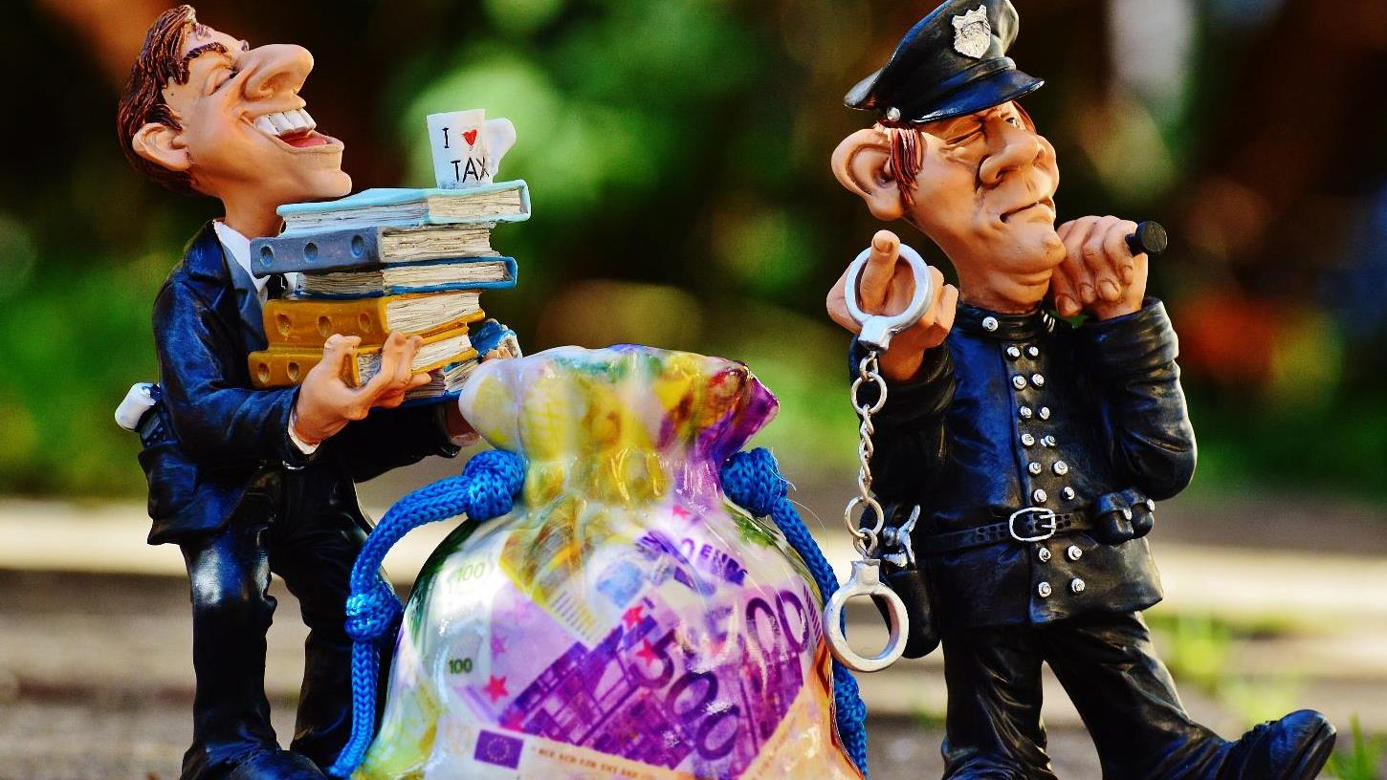
GDPR

Slide 3

Key Concepts

Slide 4
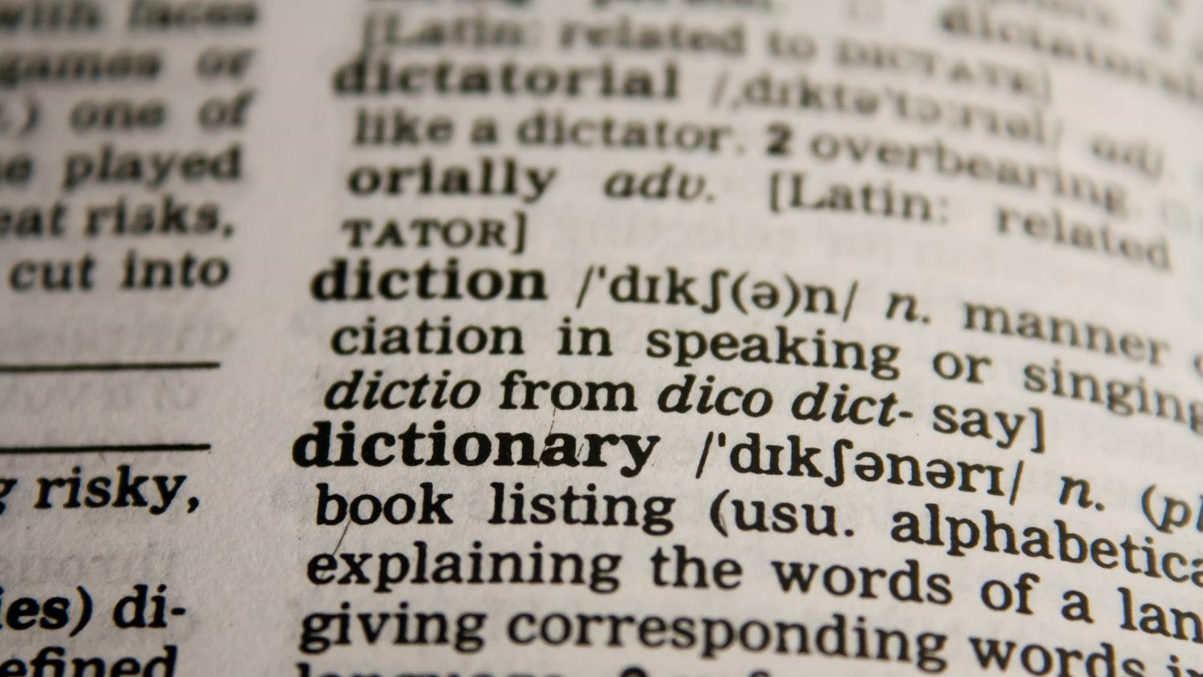
Personal Data
data by which a living individual may be identified
Processing
defined very broadly – the obtaining, recording or holding, or carrying out any operation or set of operations
Data Controller
decides the purposes for / manner in which data are processed
Data Processor
processes personal data on behalf of the data controller
Data Subjects
individuals to whom personal data relate (includes employees)
Sensitive Personal Data
subset of personal data – higher standard of care.
Notification
filing with the supervising authority in case of a personal data breach

Slide 5
GDPR: key principles
Non-compliance penalties of 4% of Annual Global Turnover or 20 Million Euro
Affect of companies processing personal data of people in EU
Data Protection Officer (DPO) may be required
Notify authorities and individuals of a breach within strict timelines
Consent must stand out, be clear and include the reasons for collection
People can decide to revoke access to their data
People have the right to obtain, change, move and delete their data
Include data protection at the design stage for a new system

Slide 6

It is not about IT alone

Slide 7

It’s worldwide

Slide 8
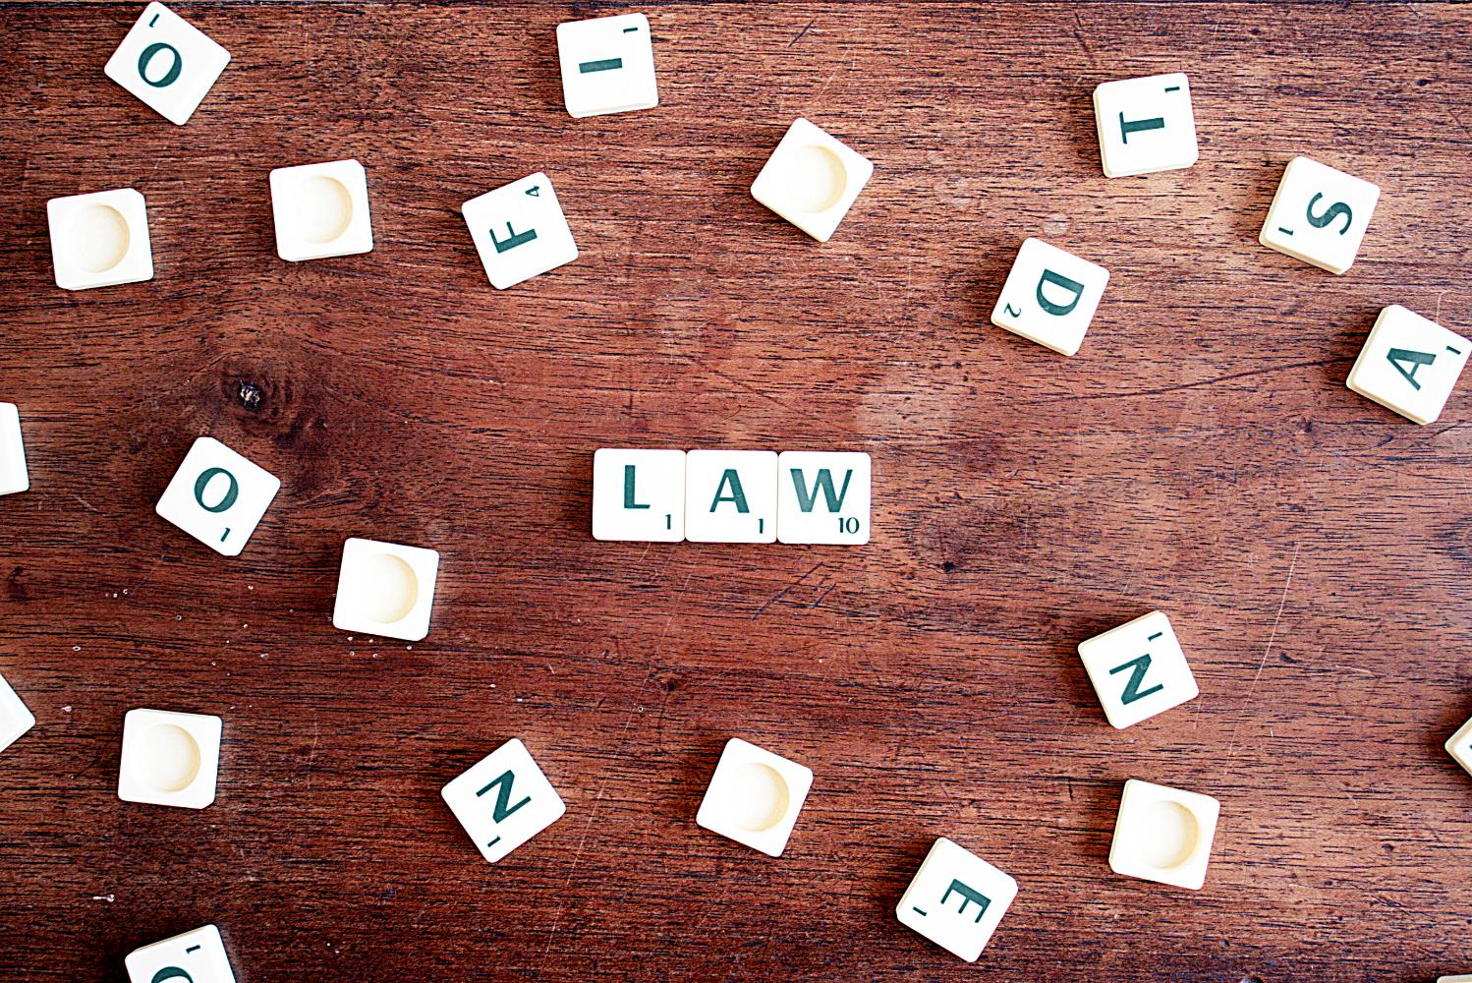
The right to be forgotten
Is not absolute

Slide 9
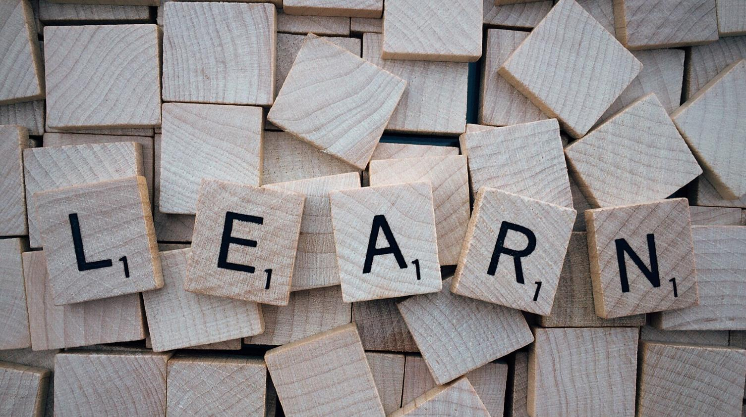
Know your Data
data by which a living individual may be identified
Manage the data
defined very broadly – the obtaining, recording or holding, or carrying out any operation or set of operations
Protect the data
decides the purposes for / manner in which data are processed
Document and comply
processes personal data on behalf of the data controller
Continuous Improvement
individuals to whom personal data relate (includes employees)

Slide 10
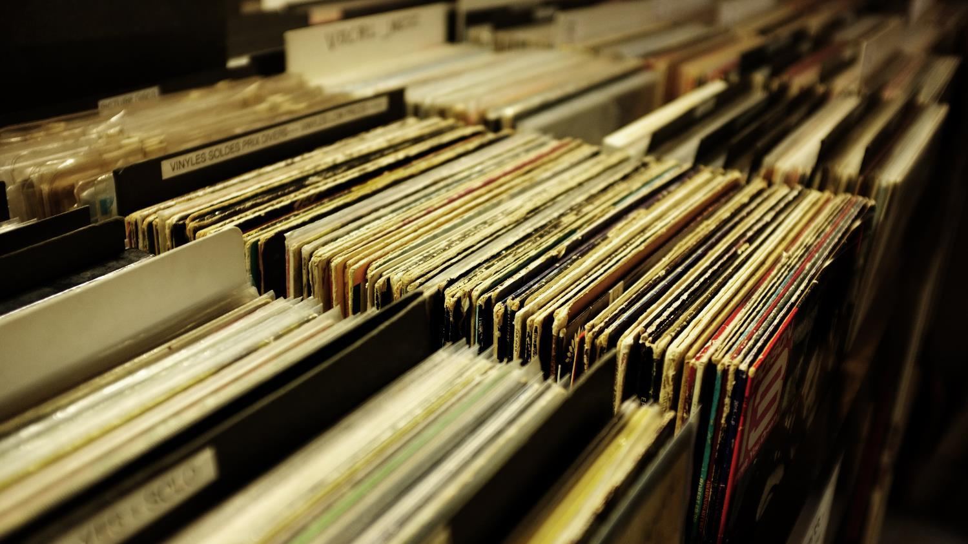
1. Know your data

Slide 11
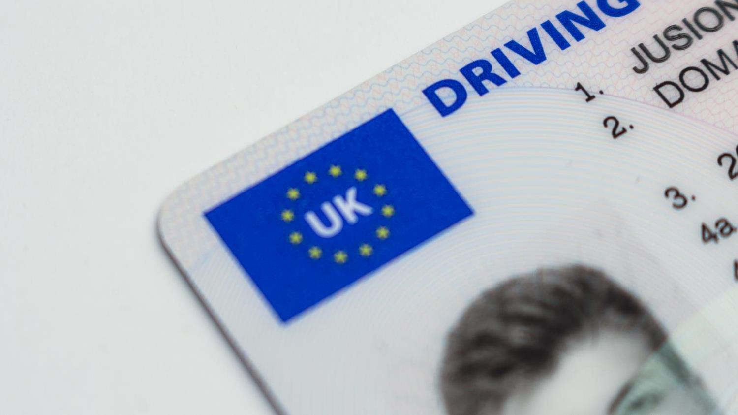
Identify

Slide 12
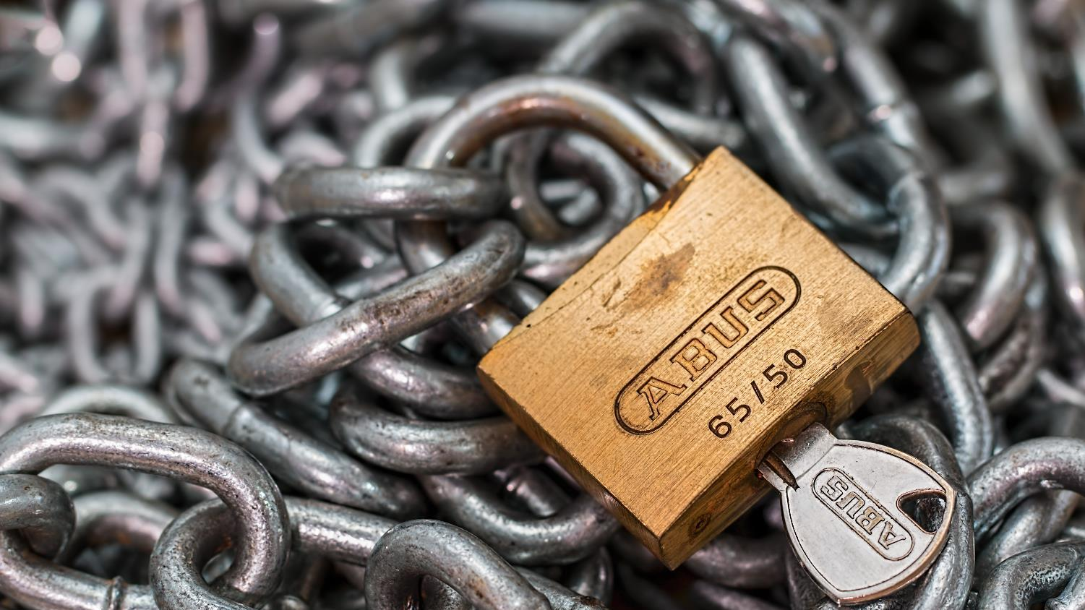
Access

Slide 13
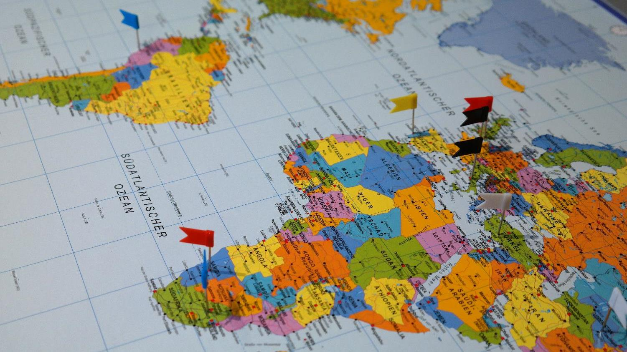
Location

Slide 14
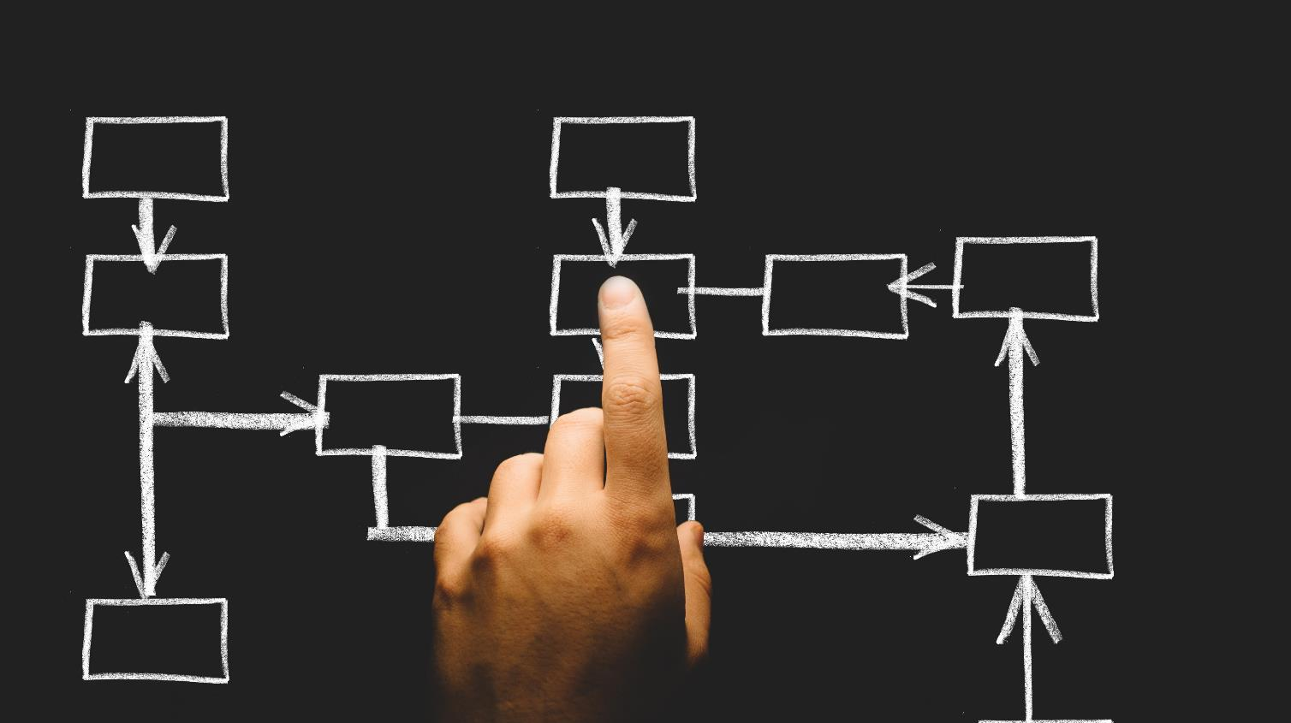
Tip: Flow charts!

Slide 15
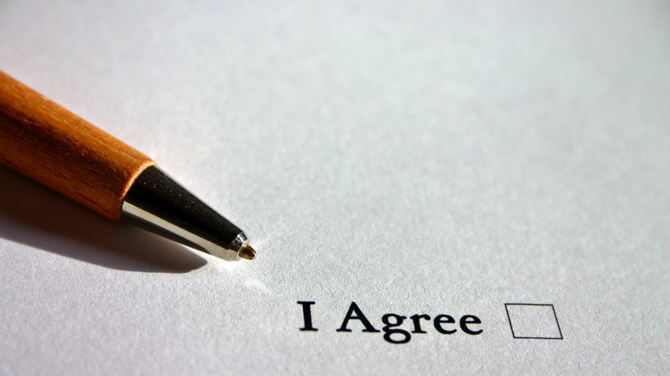
Tip: Review Opt-In!

Slide 16

2. Manage the data

Slide 17
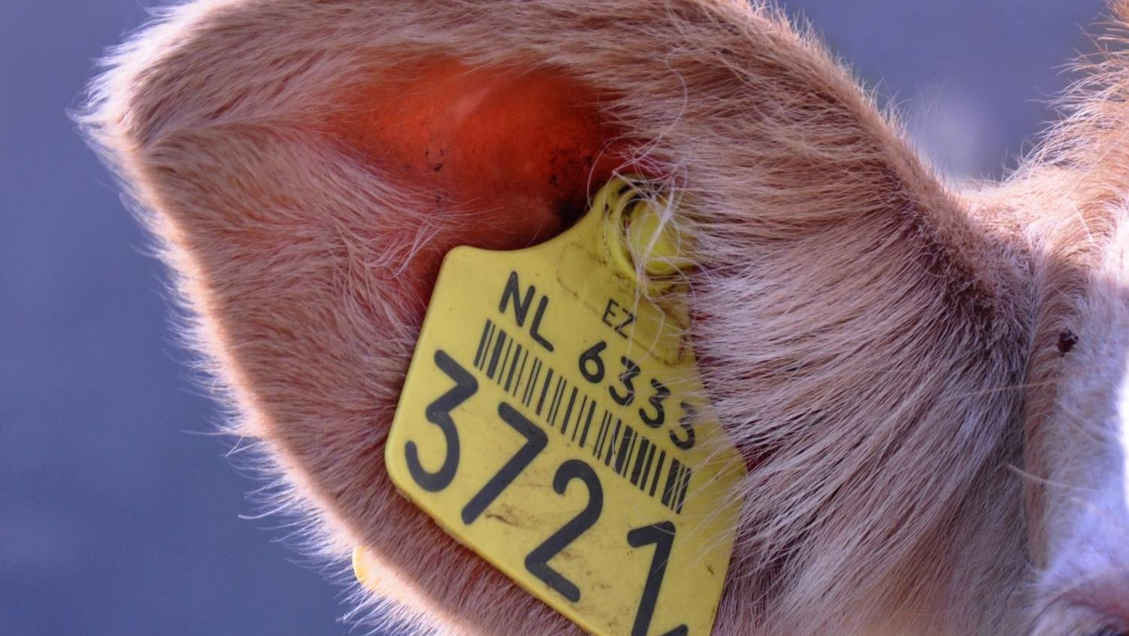
Tagging

Slide 18
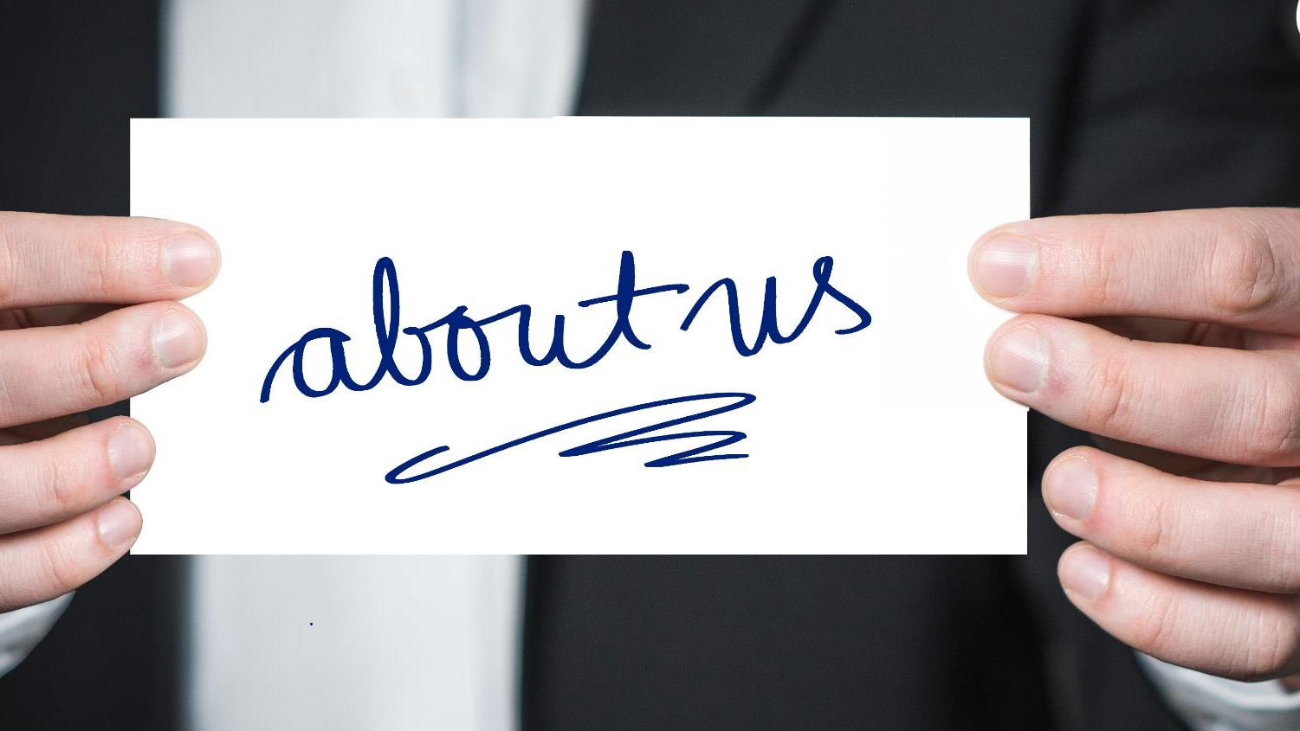
The difference

Slide 19

Partnerships

Slide 20

Why access?

Slide 21
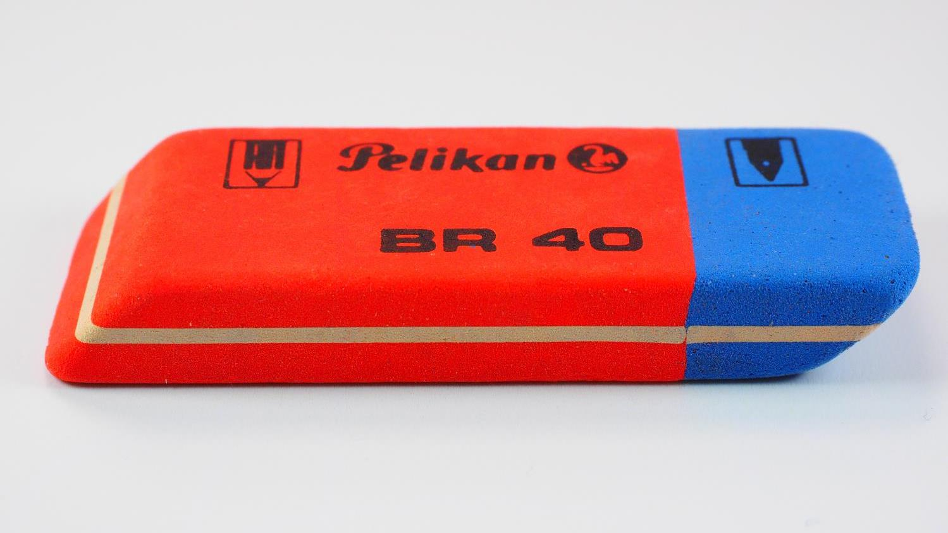
Deletion of ‘retired’ data

Slide 22
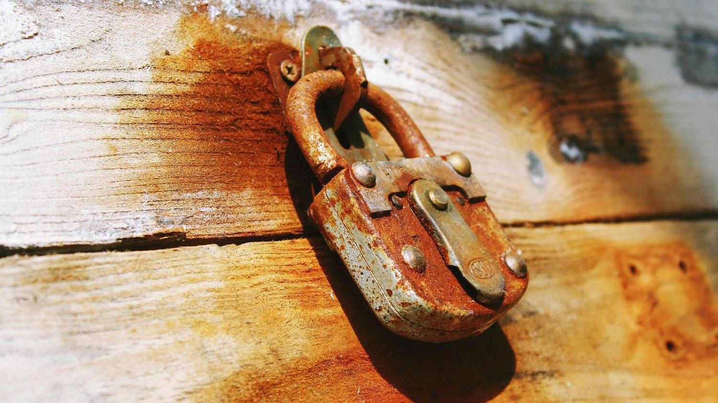
3. Protect the data

Slide 23

Security

Slide 24
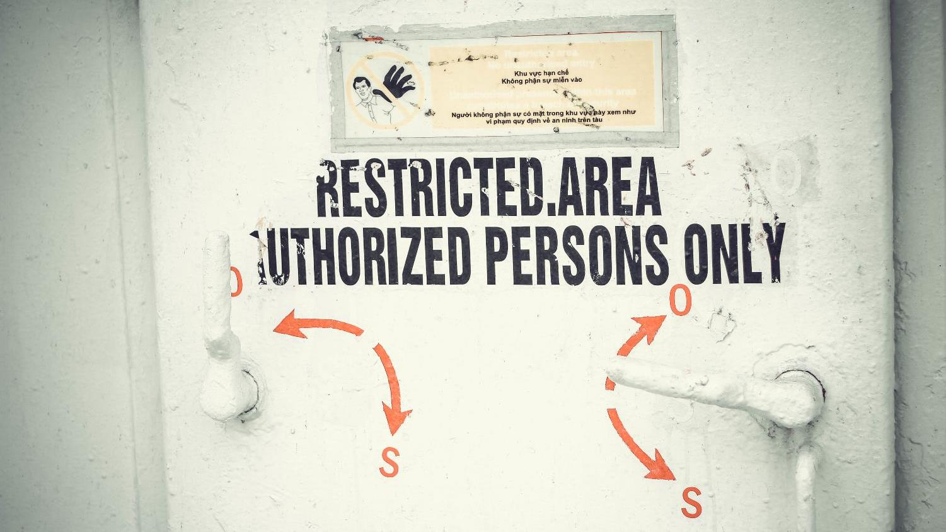
Auditing

Slide 25
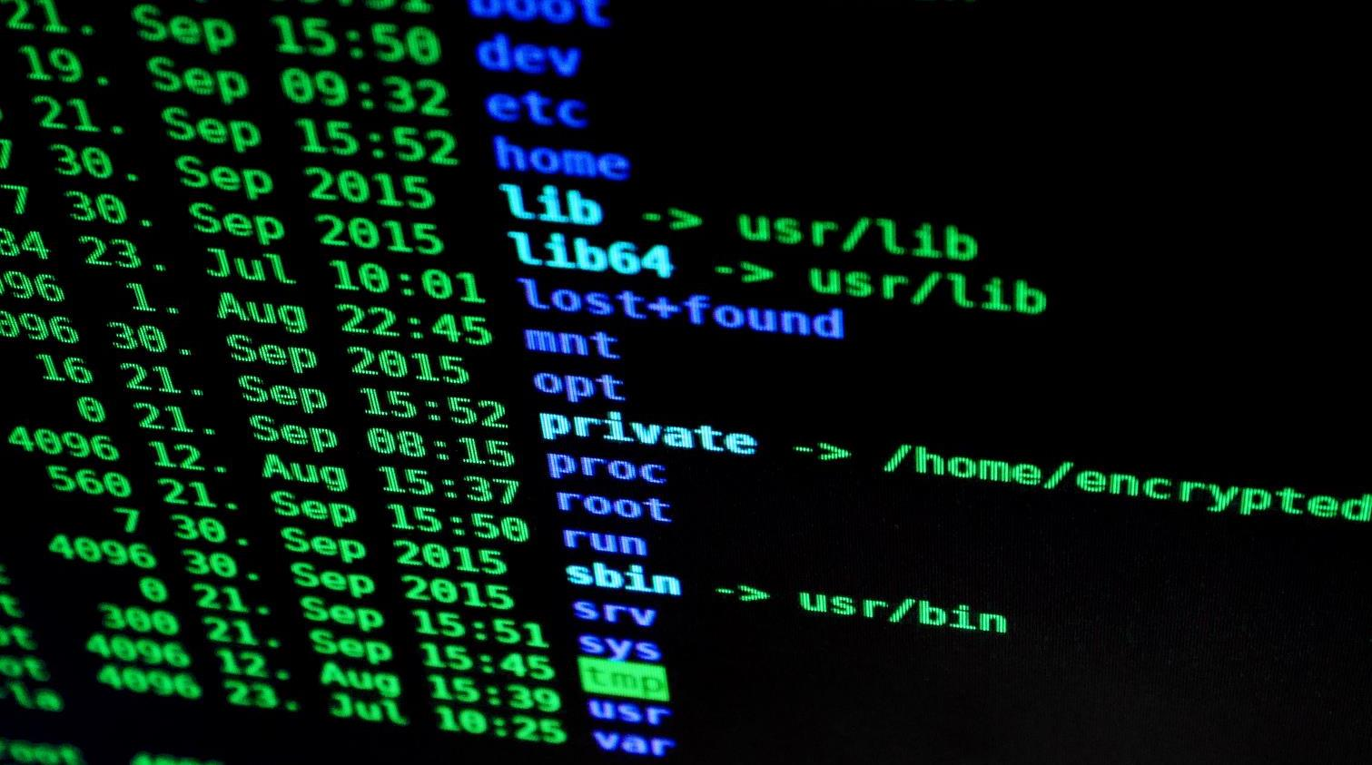
End-to-End encryption

Slide 26
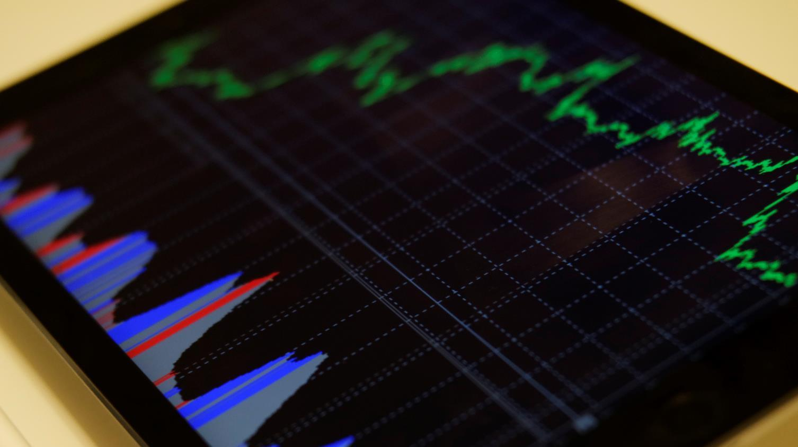
Monitoring

Slide 27

AI

Slide 28
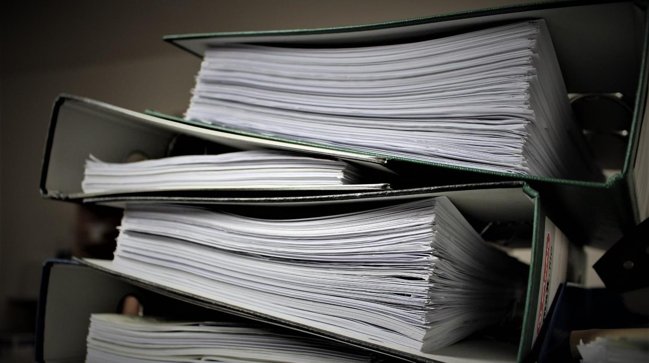
4. Document and Comply

Slide 29


Slide 30

Transfer of data

Slide 31

5. Continuously improve

Slide 32

Keep Up

Slide 33
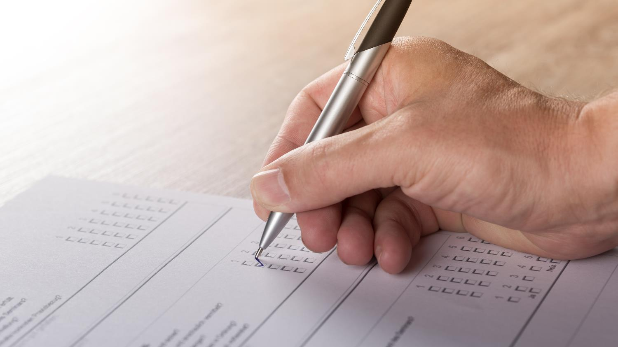
Constantly evaluate

Slide 34
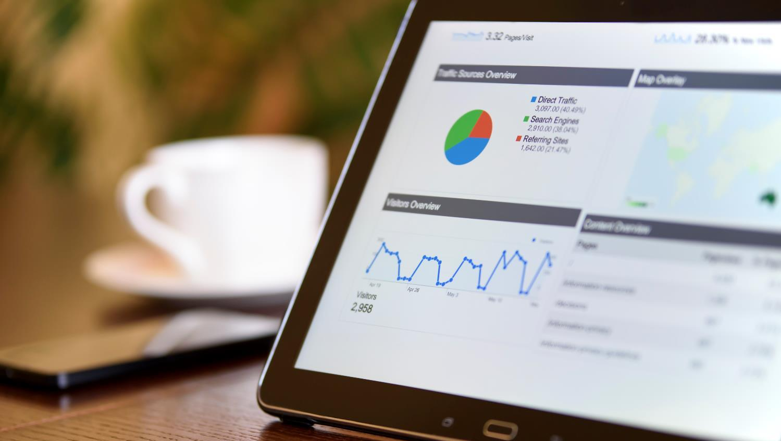
Dashboards

Slide 35
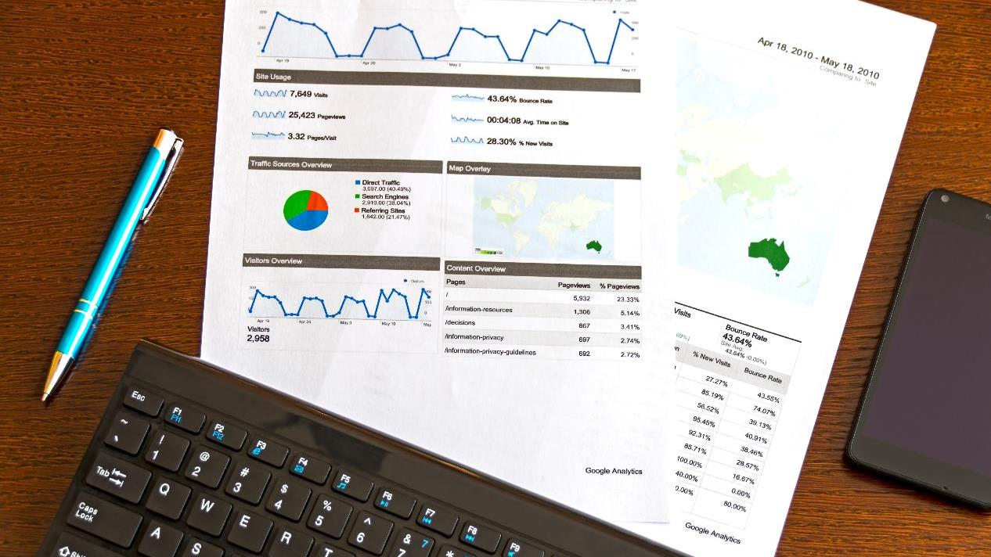
Reports

Slide 36

Redact Data

Slide 37

Breach?

Slide 38
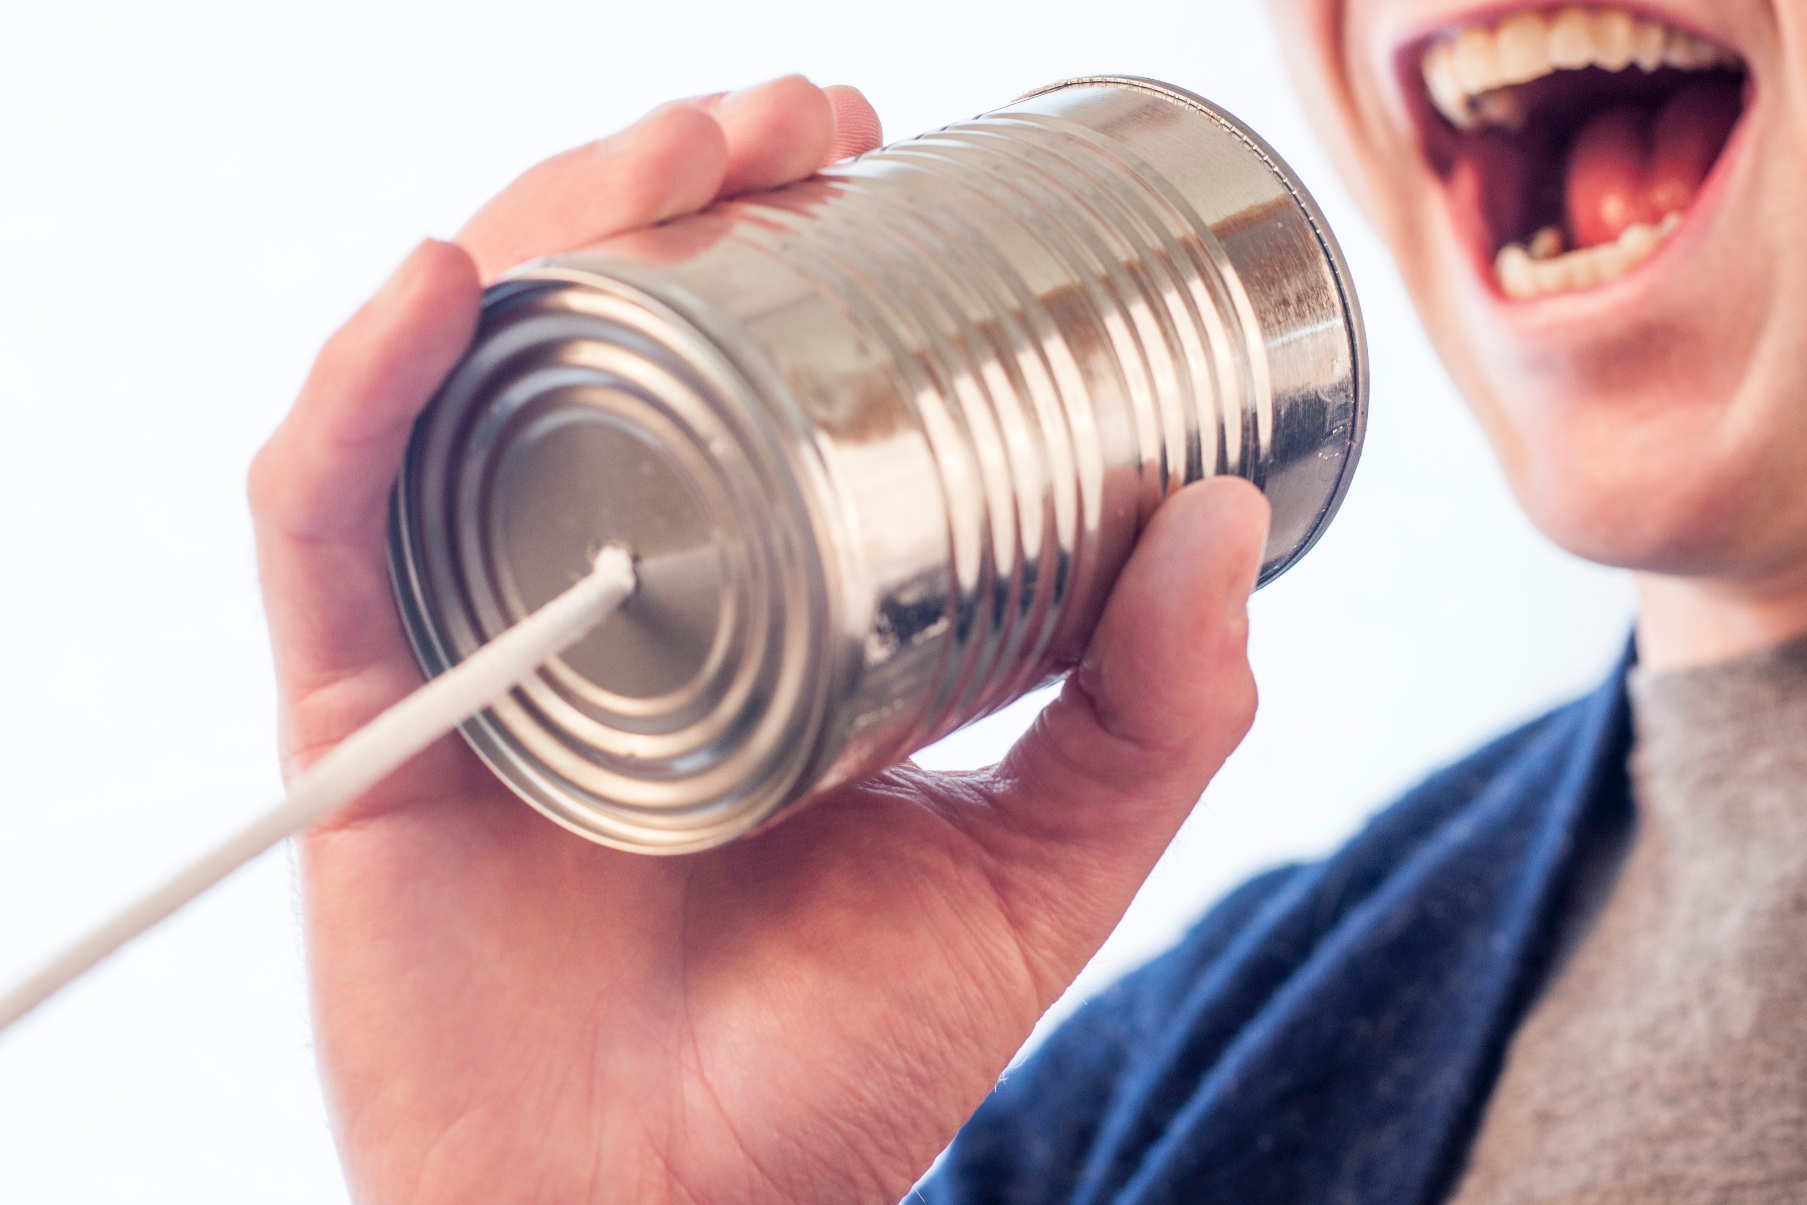
Public Statement

Slide 39
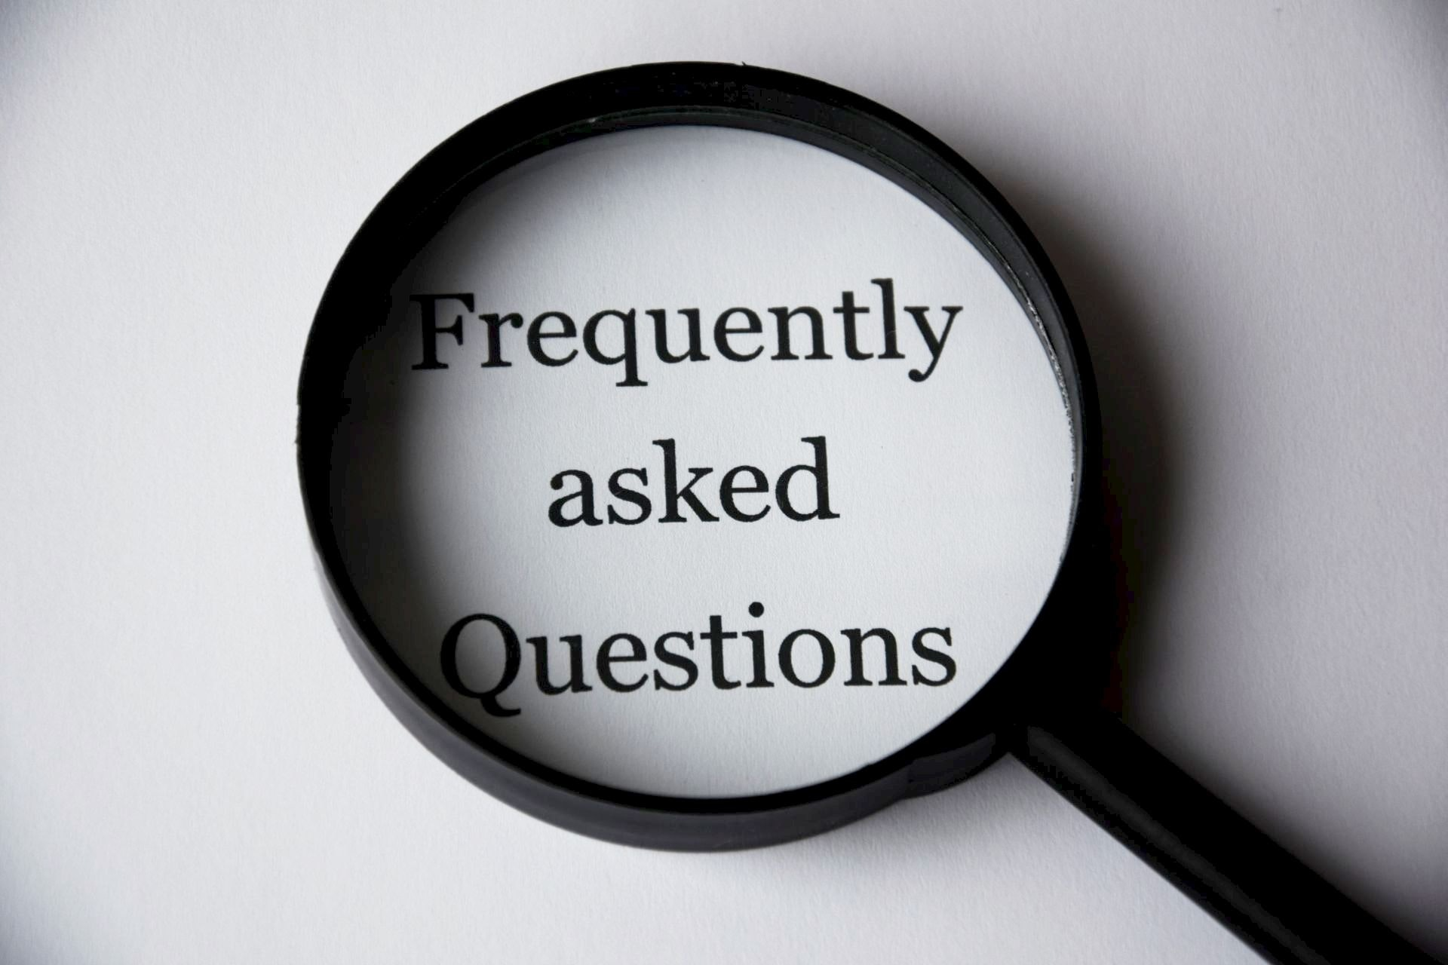
FAQ

Slide 40
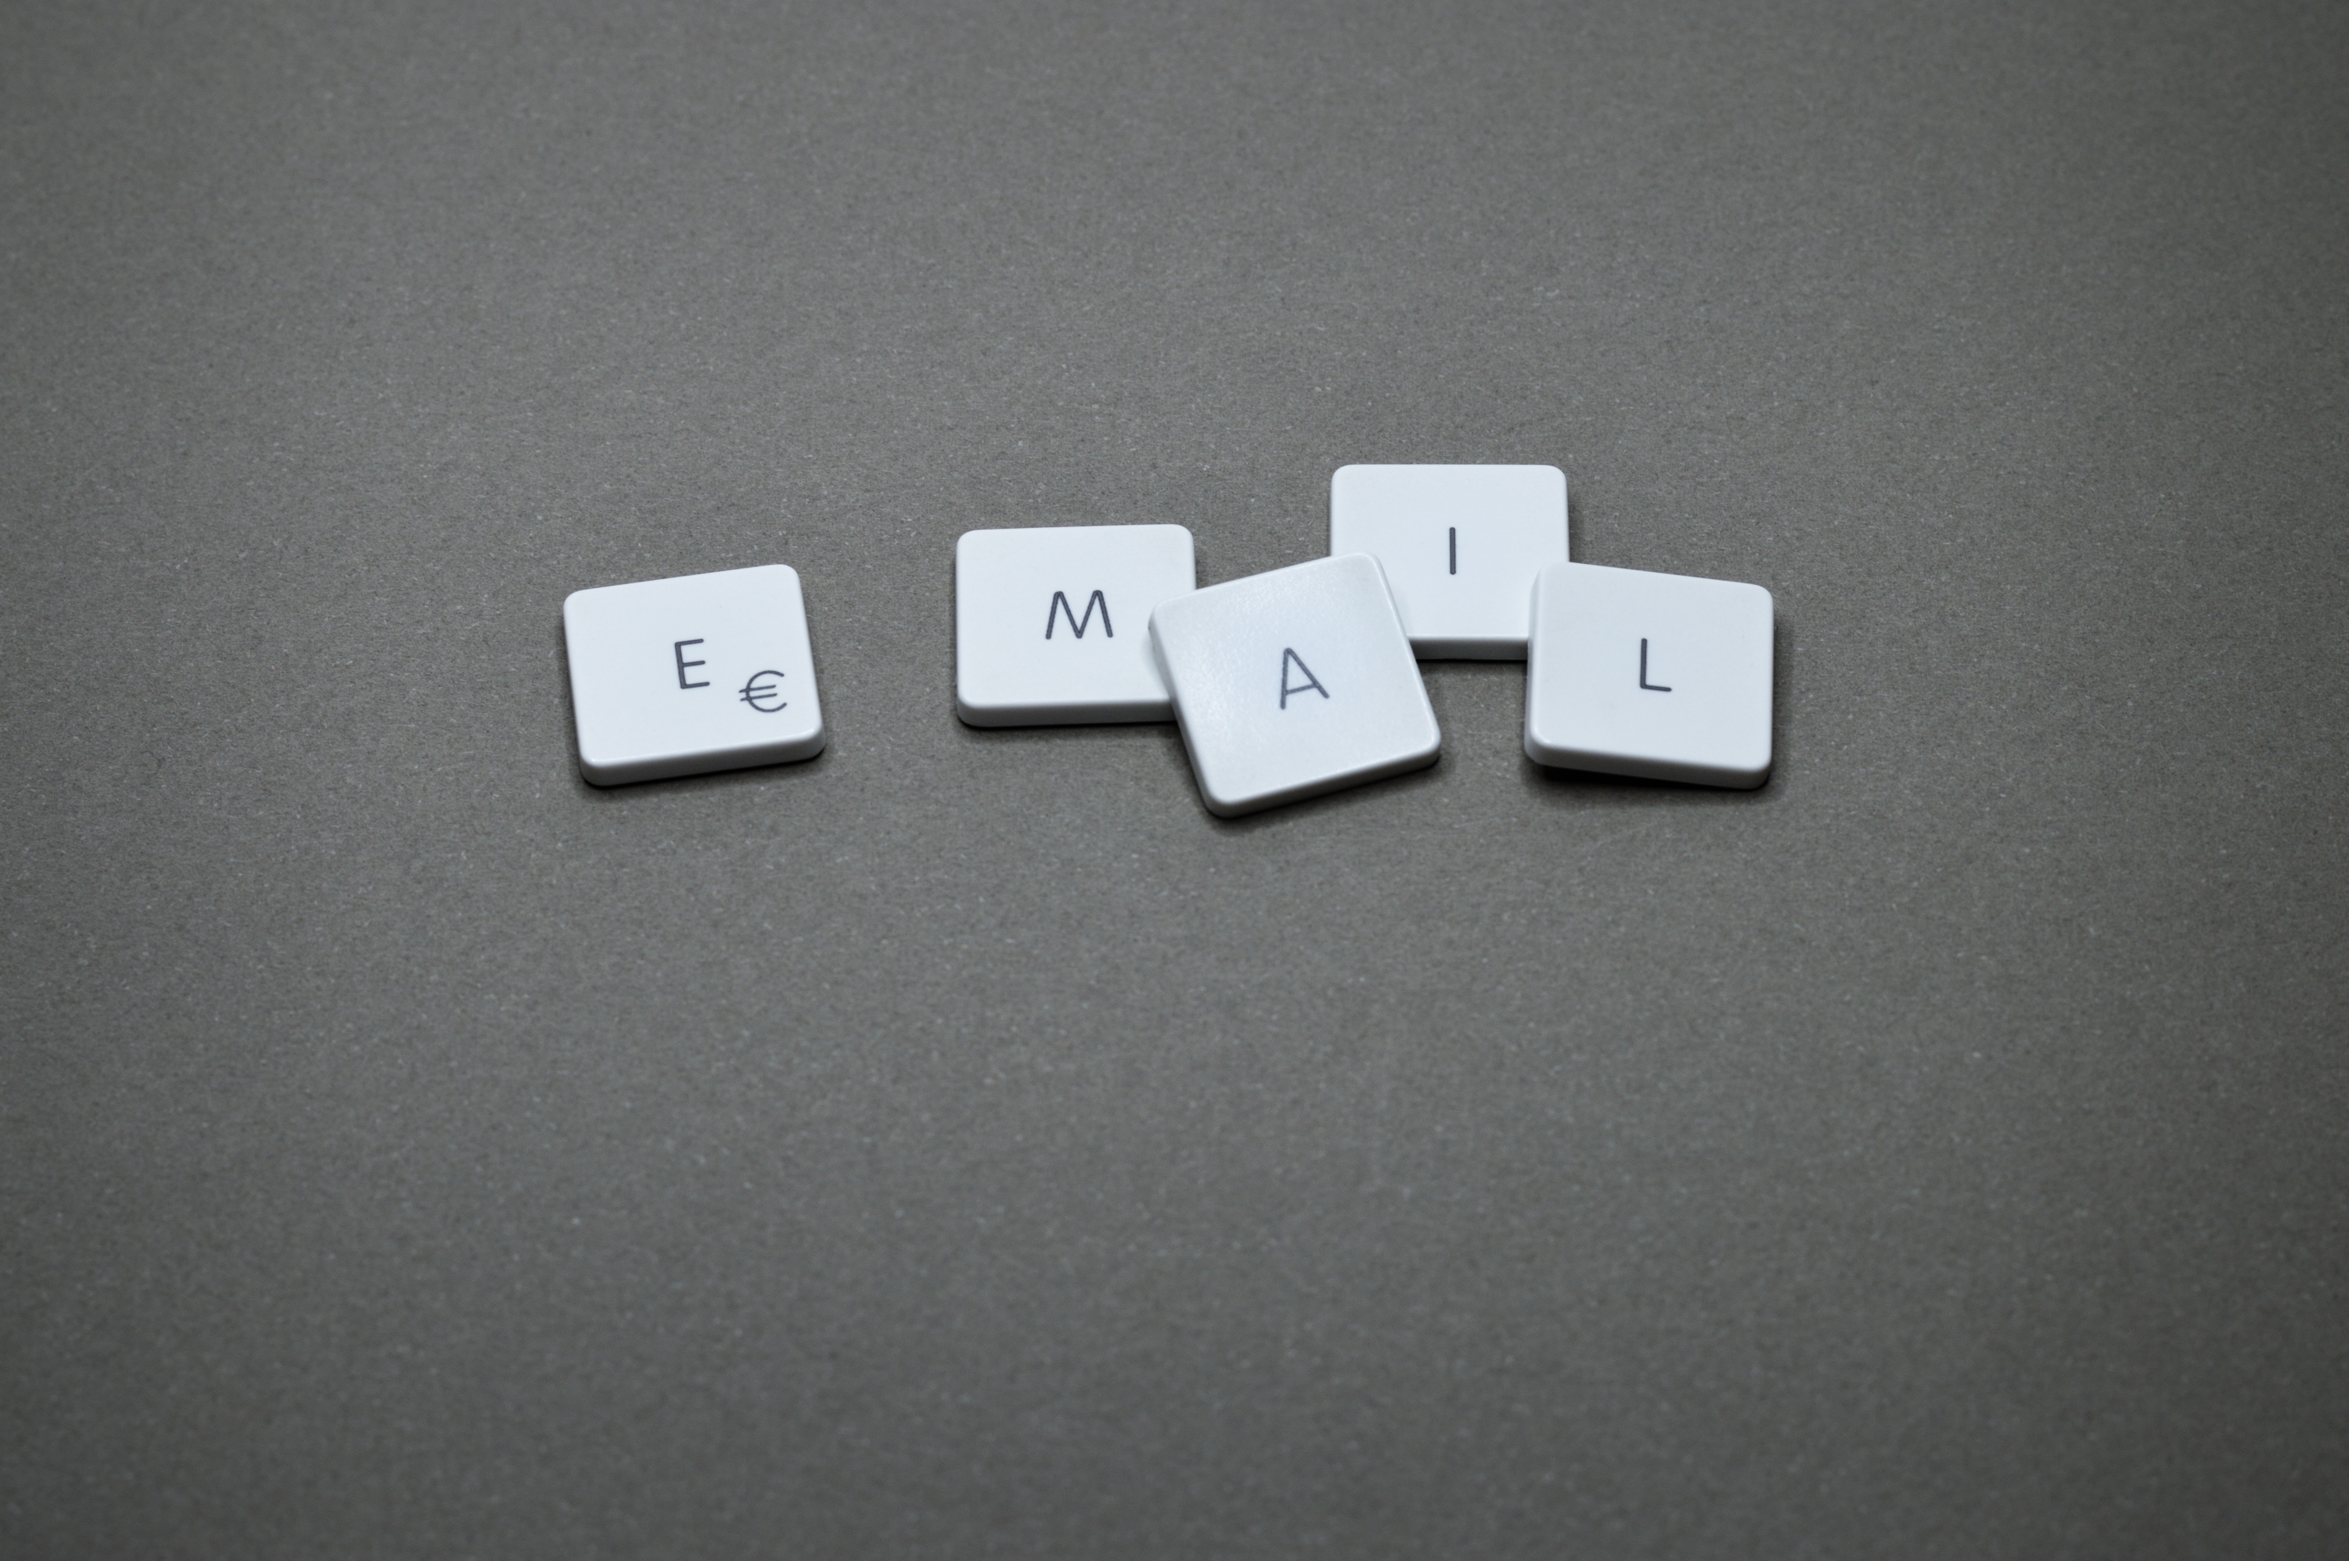
Email

Slide 41

To (personal)
What Happened
What are we doing
What You Can Do
For more information
Apologize

Slide 42
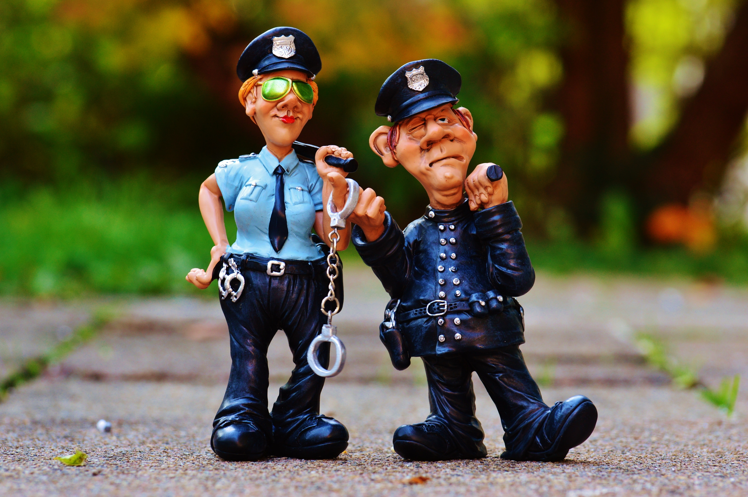
Authorities

Slide 43
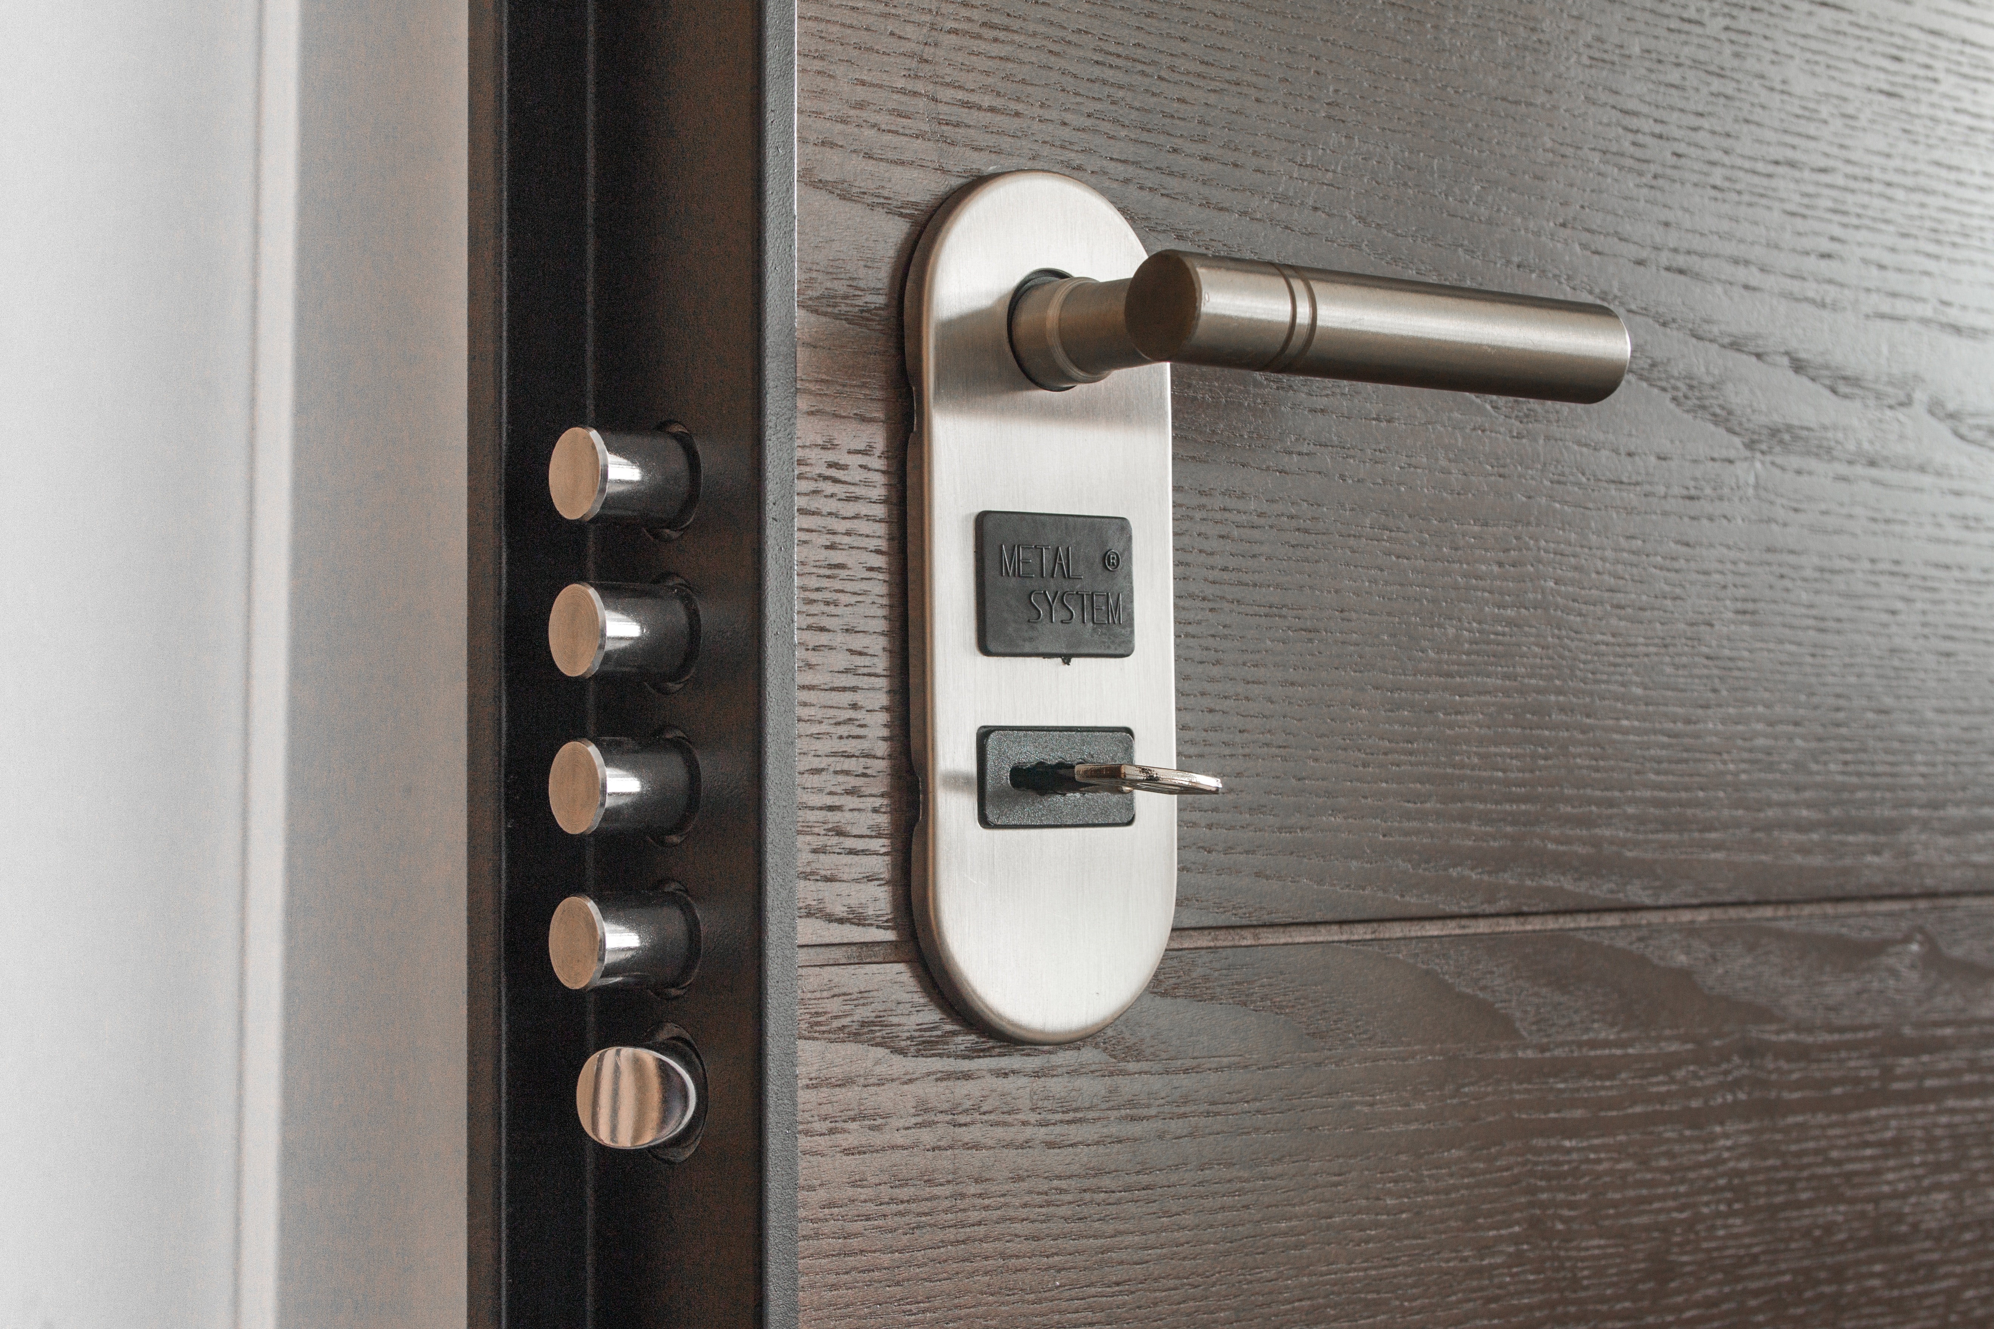
Change Password

Slide 44

Password Mechanism

Slide 45

Take Responsibility

Slide 46

Forensics

Slide 47
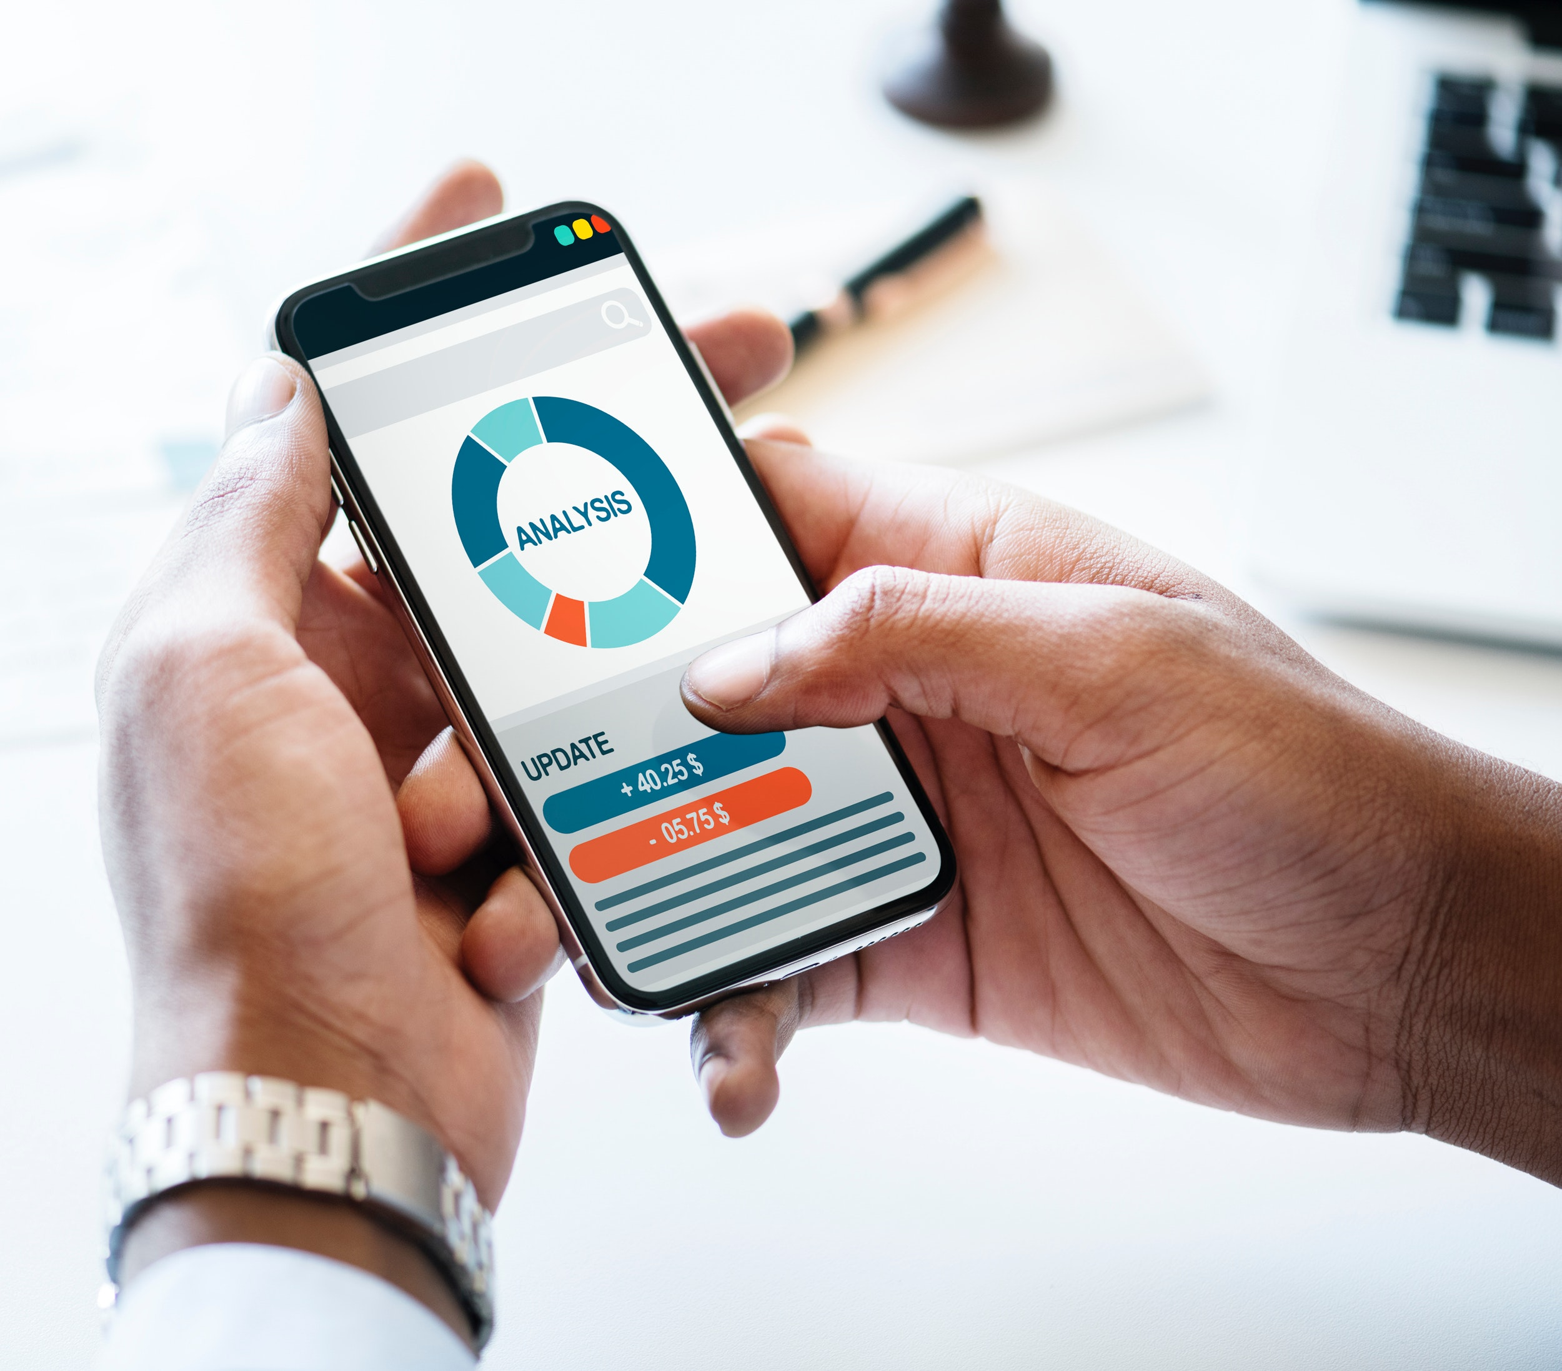
Report Afterwards

Slide 48
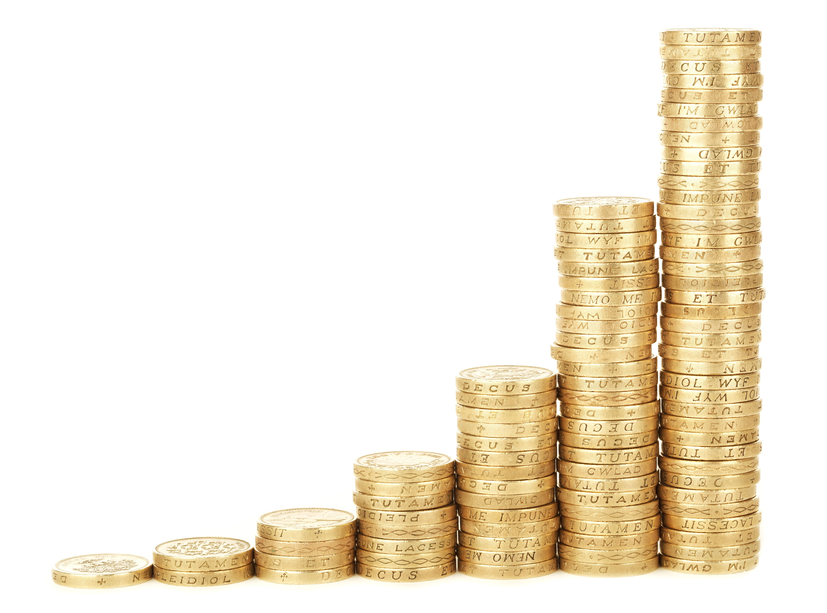
Offer Compensation

Slide 49

Fire Someone

Slide 50
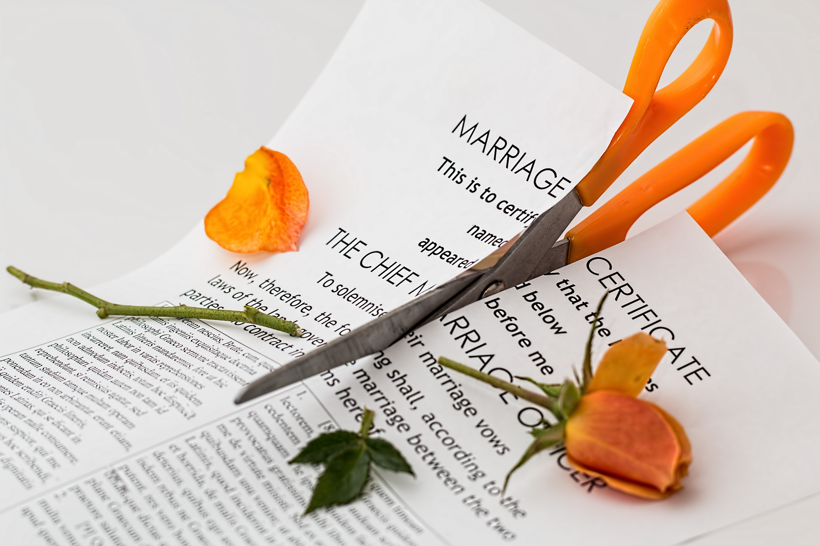
Truth

Slide 51


Slide 52


Slide 53


